Slide 1
Chapter-14
Programmable Interface Devices:
8155 I/O and Timer
8279 Keyboard/Display Interface
A programmable interface device is designed to perform various input/output functions. Such a device can be set up to perform specific functions by writing an instruction (or instructions) in its internal register, called control register.
14.1 BASIC CONCEPTS IN PROGRAMMABLE DEVICES
In Chapter 5 we assumed that the I/O devices were always ready for data transfer. But in the situation to interface a printer (a slower device) to a microprocessor (the fastest unit) there must be some signals exchanged between them prior to sending and receiving data. These signals are called handshake signals. Otherwise, processor will read the same data again and again for a slow responding input device and overwrite the previous data by the next data for a slow responding output device.

Slide 2
14.1.1 Making the 74LS245 Transceiver Programmable
The 74LS245 is a bidirectional tri-state octal buffer, and the direction of data flow is determined by the signal of DIR. When DIR is high, data flow from S to B, and when it is low, data flow from B to A.
In fact, this is a hard-wired programmable device; the direction of the data flow is programmed through DIR. However, we are interested in a device that can be programmed by writing an instruction through the MPU. This can be accomplished by adding a register called the control register, as shown in Figure 14.2, and by connecting the DIR signal to bit D_{o} of the control register. When D_{o} = 1, data flow from A to B as output, and when D_{o} = 0, data flow in the opposite direction as input.
Example 14.1: Write instructions to initialize the hypothetical chip (Figure 14.2) as an output buffer.
Solution: Instructions
MVI A,01H
OUT FFH
MVI A, BYTE1
OUT FEH

Slide 3
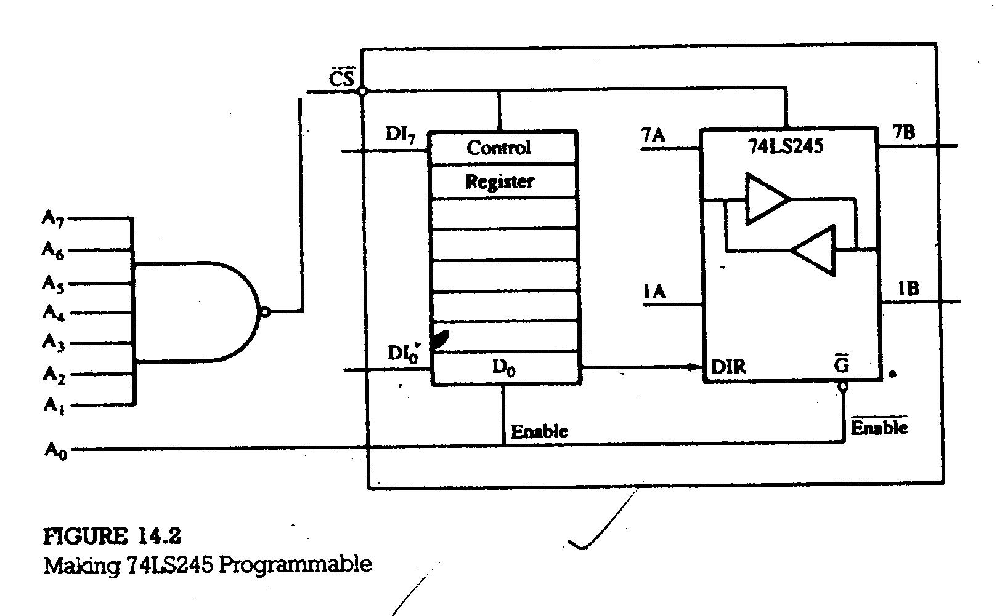

Slide 4
14.1.2 Programmable Device with a Statues Register
Figure 14.3 shows a hypothetical programmable device with a status register. There are three registers and can be accessed as ports. The port addresses and the functions of these registers can be summarized as follows:
Control register (output only) = FFH (A₁ and A₀ = 1)
Status register (input only) = FFH (A₁ and A₀ = 1)
Data register (input or output) = FFH (A₁=1, A₀ = 0)
14.1.3 Programmable Device with a Handshake Signals
The MPU and peripherals operate at different speeds; therefore, signals are exchanged prior to data transfer between fast-responding MPU and slow-responding peripherals such as printers and data converters. These signals are called handshake signals. These signals are generally provided by programmable devices.
Figure 14.4(a) shows a programmable device in the input mode, with two handshake signals: STB (Strobe) and IBF (Input Buffer Full) and one interrupt signal (INTR). Figure 14.4(b) shows the programmable device in the output mode using the same handshake signals, except that they are labeled differently: OBF (Output Buffer Full) and ACK (Acknowledgement).

Slide 5
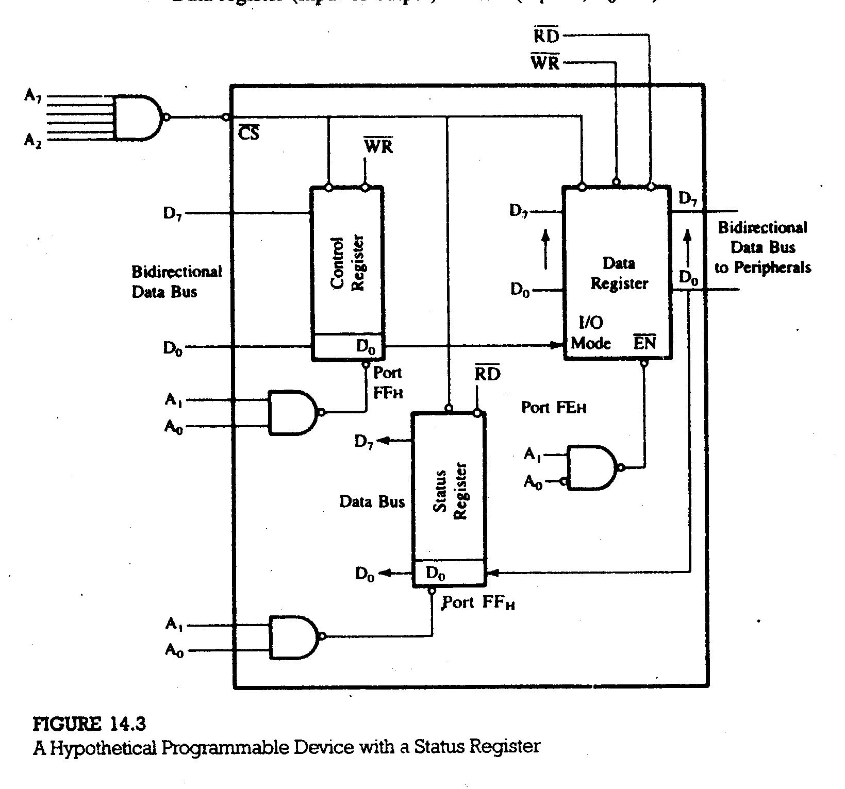

Slide 6
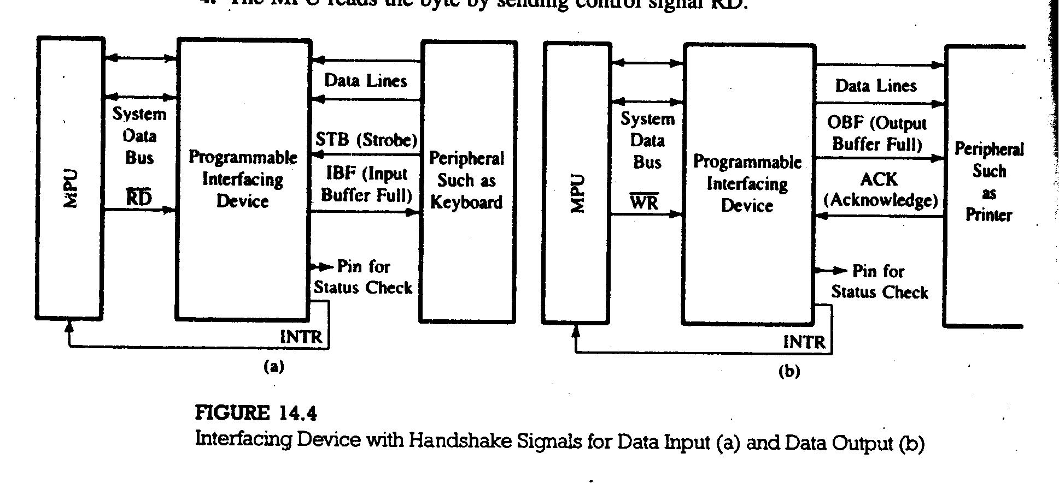

Slide 7
Examination of Figure 14.4 shows the following similarities among the handshake signals:
1. Handshake signals ACK and STB are input signals to the device and
perform similar functions, although they are called by different names.
2. Handshake signals OBF and IBF are output signals from the device and
perform similar functions (Buffer Full).
14.2 THE 8155: MULTIPURPOSE PROGRAMMABLE DEVICE
The 8155 is a multipurpose programmable device specially designed to be compatible with the 8085 microprocessor. The ALE, IO/M, RD, and WR signals from the 8085 can be connected directly to the device; this eliminates the need for external demultiplexing of the low-order bus AD₇ – AD₀ and generation of the control signals such as MEMR, MEMW, IOR, and IOW.
The 8155 includes 256 bytes of R/W memory, three I/O ports, and a timer. Figure 14.5 shows the pin configuration and block diagram of the 8155 programmable device. The programmable I/O sections of this device are illustrated in the following sections:

Slide 8
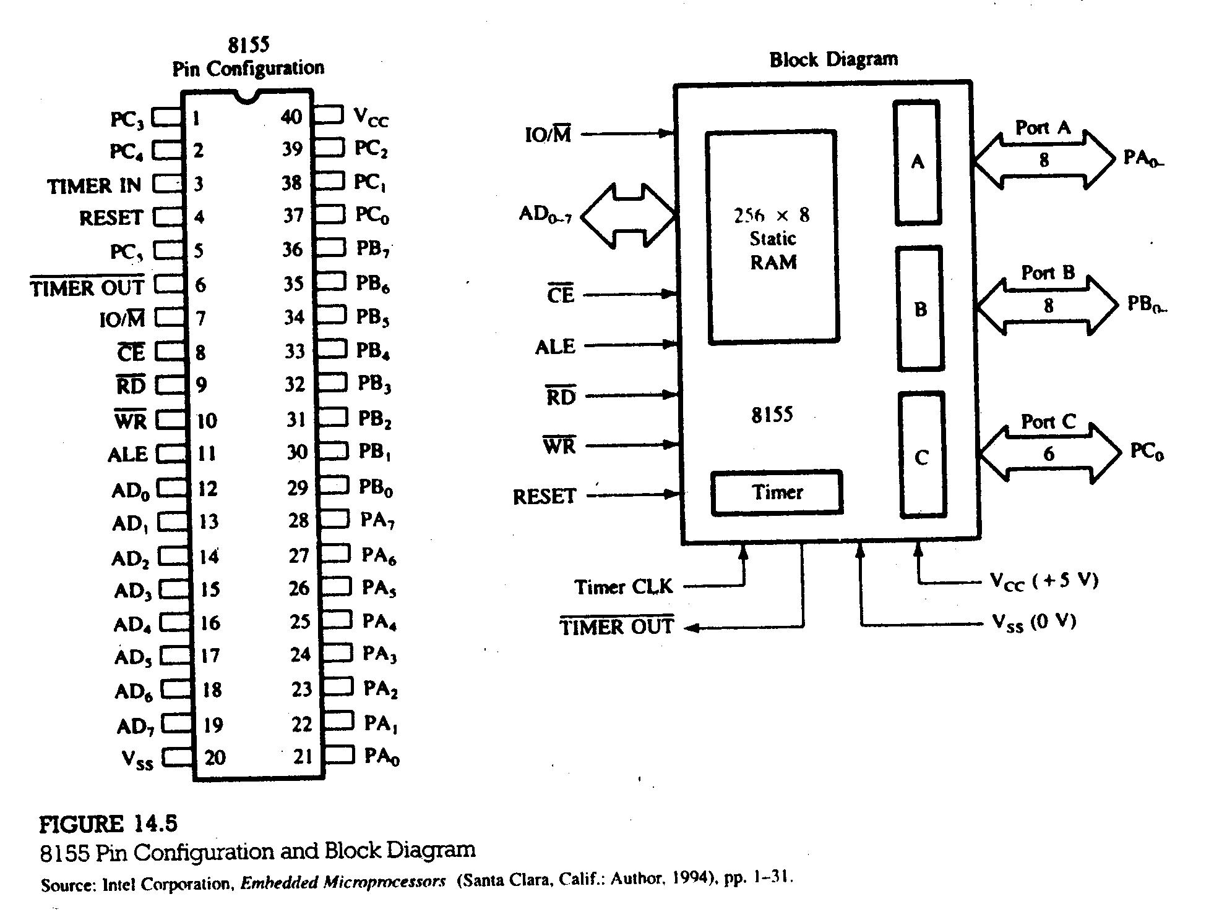

Slide 9
14.2 The 8155 Programmable I/O Ports and Timer
The 8155 is a device with two sections: the first is a 256 bytes R/W memory, and the second is a programmable I/O. Functionally, these two sections can be viewed as two independent chips.
The I/O section includes two 8-bit parallel I/O ports (A and B), one 6-bit port (C), and a timer (Figure 14.5). All the ports can be configured simply as input/output ports. Ports A and B also can be programmed in the handshake mode, each port using three signals from port C. The timer is a 14-bit down-counter and has four modes.
THE 8155 I/O PORTS
The I/O section of the 8155 includes a control register, three I/O ports, and two registers for the timer (Figure 14.6).
To communicate with the peripherals through the 8155 the following steps are necessary:
1. Determine the address (port numbers of the registers and I/Os) based on
the Chip Enable logic and address lines AD₀, AD₁, and AD₂.

Slide 10
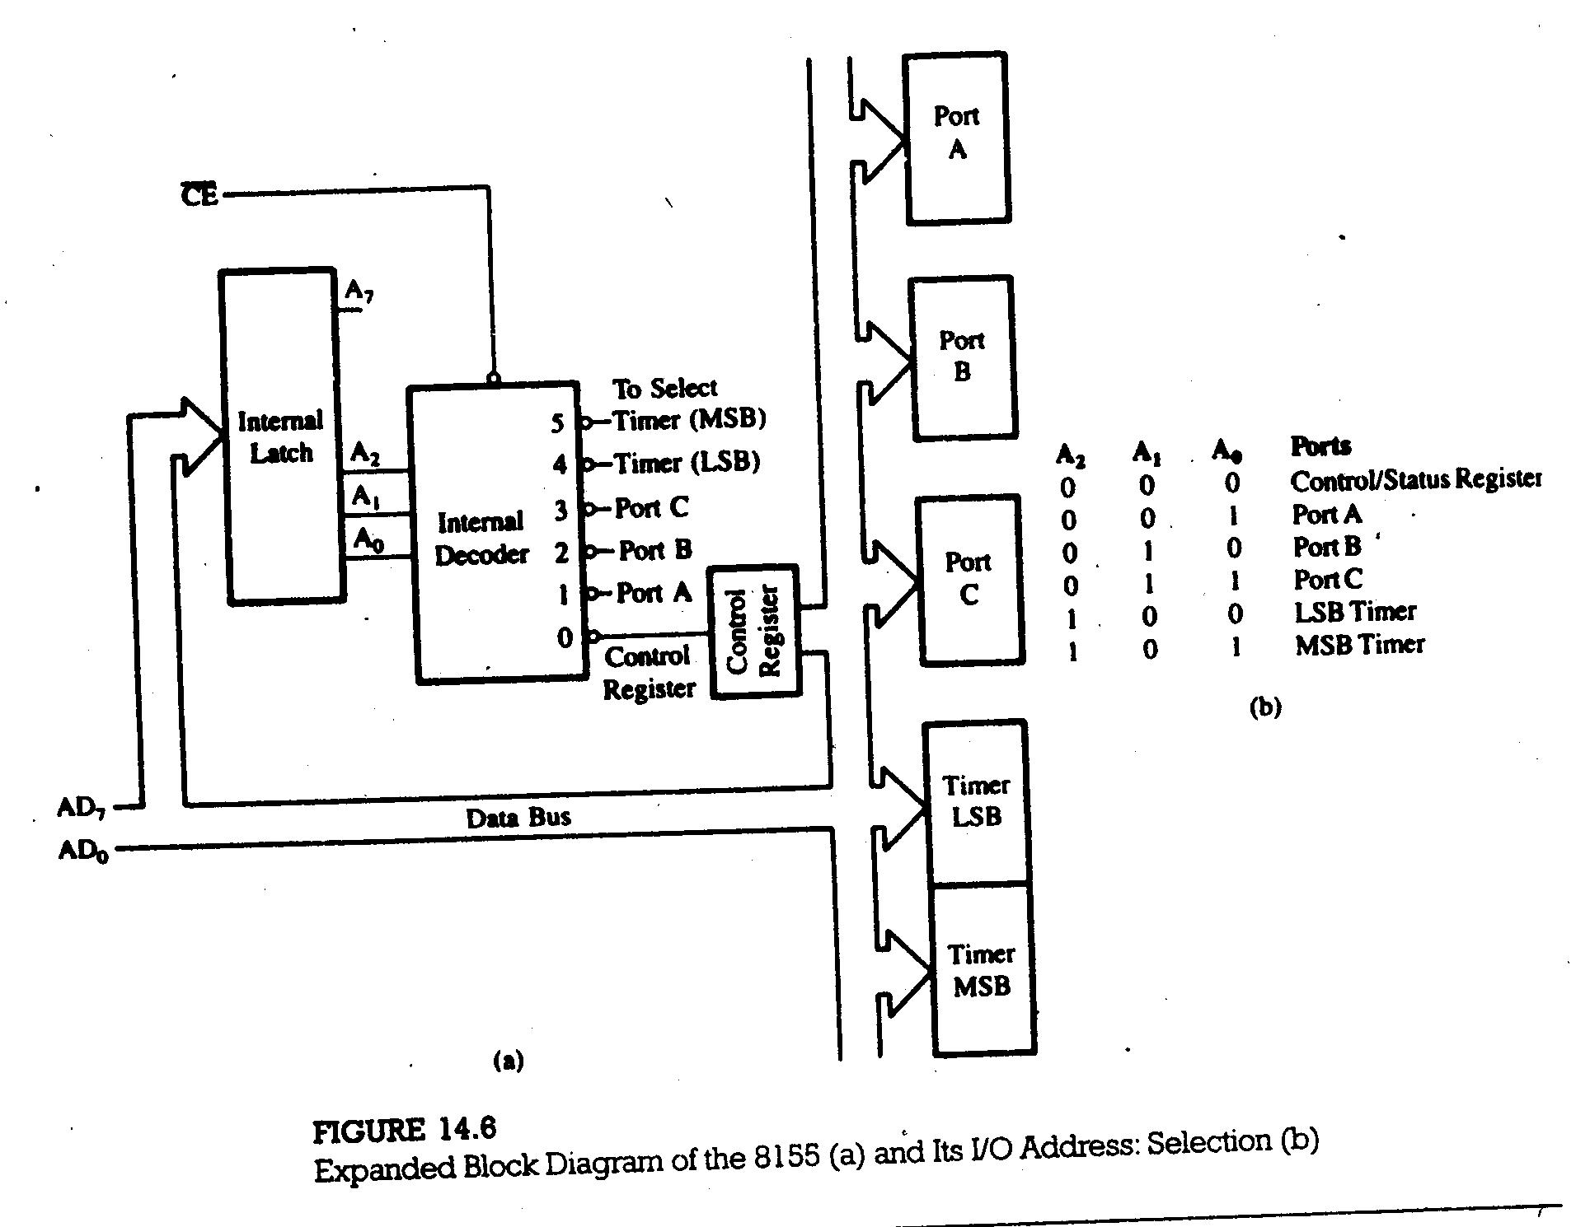

Slide 11
2. Write control word in the control register to specify I/O functions of the ports
and the timer characteristics.
3. Write I/O instructions to port addresses to communicate with peripherals.
4. Read the status register, if necessary, to verify the status of the I/O ports
and the timer. In simple applications, this step is not necessary.
CHIP ENABLE LOGIC AND PORT ADDRESSES
Address lines AD₂ – AD₀ also shown as A₂ – A₀ after internal demultiplexing, select one of the registers, as shown in Figure 14.6(b). Address lines A₃ – A₇ are don’t care lines; however, the logic levels on the corresponding high-order lines, A₁₁ – A₁₅ , will be duplicated on lines A₃ – A₇.
Example 14.2: Determine the addresses of the control/status register, I/O
ports, and timer registers in Figure 14.7.
Solution: To select the chip, the output line of the 8205 (3-to-8) decoder (Figure
14.7) should go low:
A₁₅ A₁₄ A₁₃ A₁₂ A₁₁
0 0 1 0 0

Slide 12
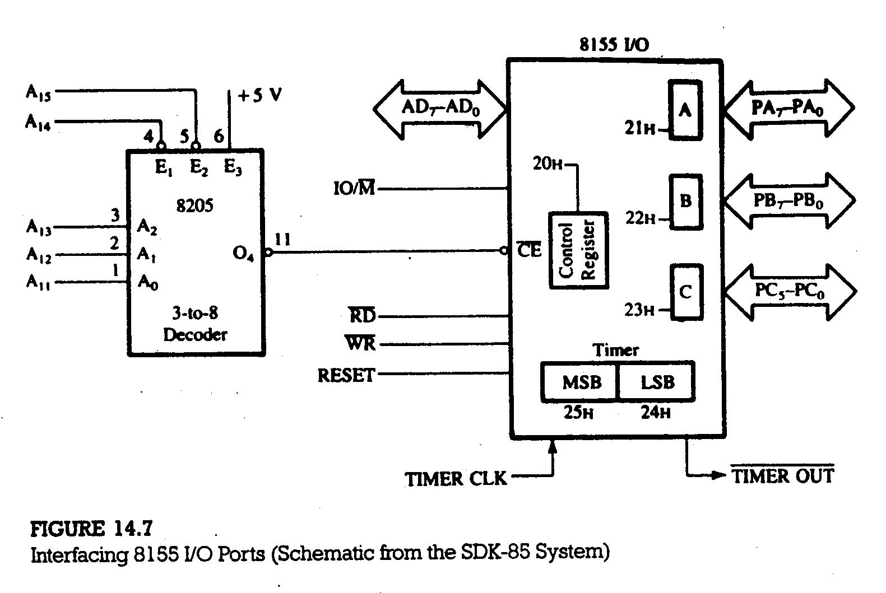

Slide 13
By combining five high-order address lines with three low-order address lines (A2 – A0), the port numbers in Figure 14.7 will range from 20H to 25H shown below:
A₁₅ A₁₄ A₁₃ A₁₂ A₁₁ AD₂ AD₁ AD₀ = Address Ports
0 0 1 0 0 0 0 0 = 20H – CR or SR
0 0 1 = 21H – Port A
0 1 0 = 22H – Port B
0 1 1 = 23H – Port C
1 0 0 =24H–Timer(LSB)
A₇ A₆ A₅ A₄ A₃ 1 0 1 =25H–Timer(MSB)
N.B. For I/O-mapped I/O ( or port-addressed I/O or peripheral I/O) the low-
order address and high-order address bus carry the same information.
CONTROL WORD
The I/O ports and the timer can be configured by writing a control word in the control register. The control register bits are defined as shown in Figure 14.8.
2H

Slide 14
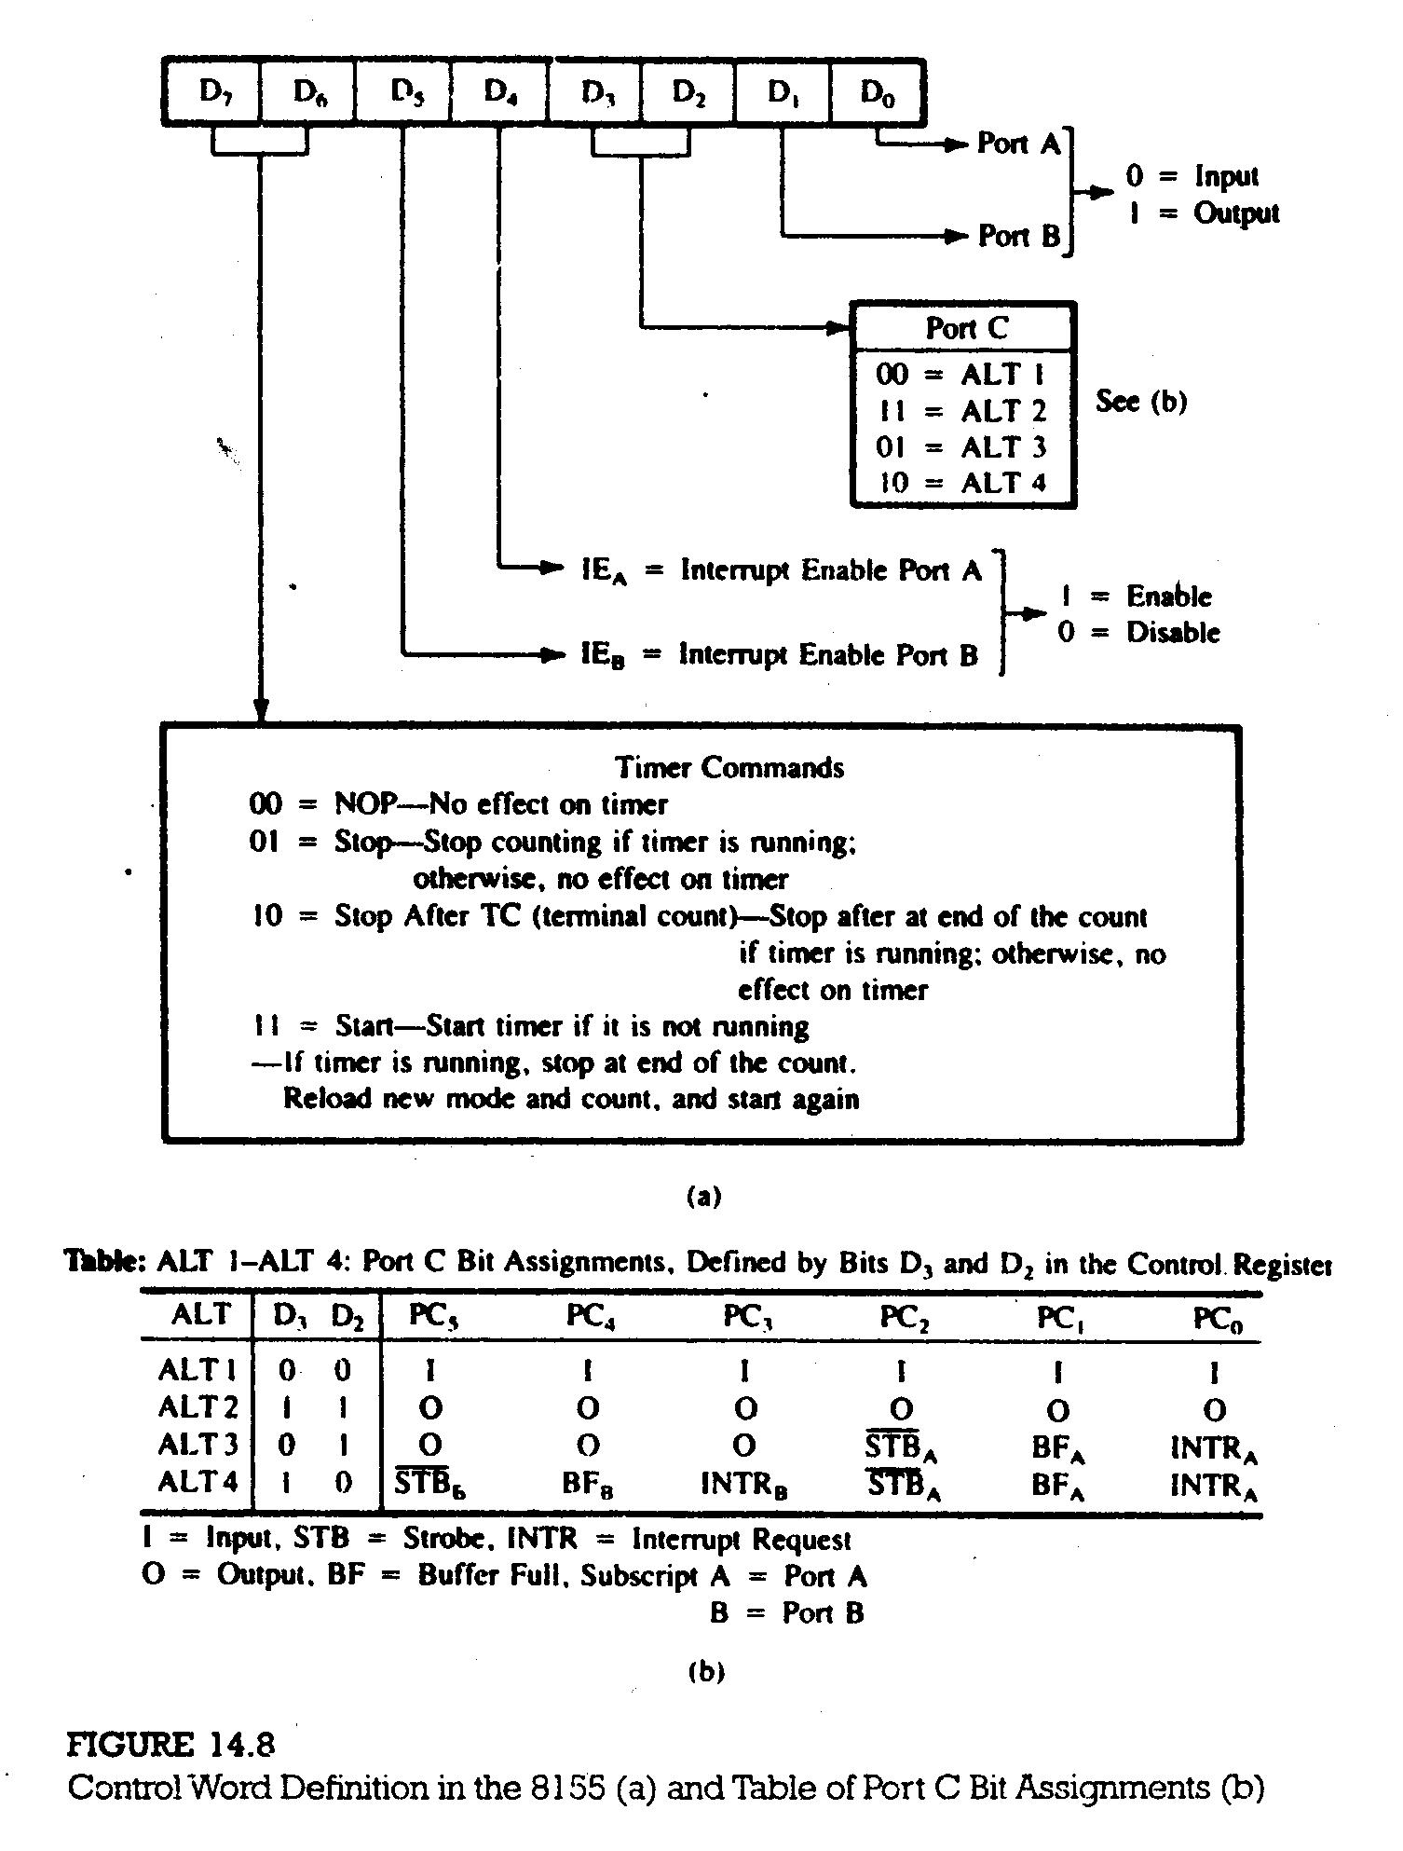

Slide 15
Bit D₂ and D₃ determine the functions of port C; their combination specifies one of the four alternatives, from simple I/O to interrupt I/O, as shown in Figure 14.8(b). Bits D₄ and D₅ are used only in the interrupt mode to enable or disable internal flip-flops of the 8155. These bits do not have any effect on the Internal Enable (INTE) flip-flop of the MPU.
14.2.2 Illustration: Interfacing Sven Segment LED Output Ports Using the
8155
PROBLEM STATEMENT
1. Design two seven-segment-LED displays using ports A and B of the 8155.
2. Write initialization instructions and display data bytes at each port.
HARDWARE DESCRIPTION
The decode logic is the same as that used in the previous discussion; therefore, the port addresses are as follows:
Control Register = 20H
Port A = 21H
Port B = 22H

Slide 16
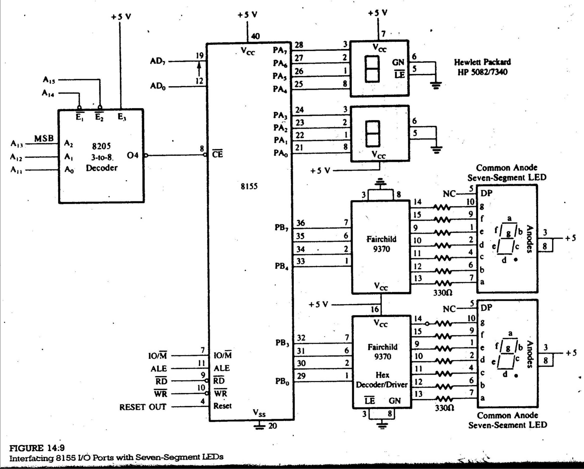

Slide 17
CONTROL WORD
To configure ports A and B as outputs, the control word is as follows:
D₇ D₆ D₅ D₄ D₃ D₂ D₁ D₀
0 0 0 0 0 0 1 1 = 03H
PROGRAM
      MVI A, 03H
      OUT 20H
      MVI A, BYTE1
      OUT 21H
      MVI A,BYTE2
      OUT 22H
      HLT

Slide 18
14.2.3 The 8155 Timer
The timer section of the 8155 has two 8-bit registers; 14 bits are used for the counter, two bits for the timer mode, and it requires a clock as an input. This 14-bit down counter provides output in four different modes, as described in Figure 14.(b).
The timer can be stopped either in the midst of counting or at the end of a count (applicable to Modes 1 and 3).
14.2.4 Illustration: Designing a Square-Wave Generator Using the 8155
Timer
PROBLEM STATEMENT
Design a square-wave generator with a pulse width of 100 µs by using the 8155 timer. Set up timer in Mode 1 if the clock frequency is 3 MHz. Use the same decode logic and the port addresses as in Example 14.2 (Figure 14.7).
PROBLEM ANALYSIS
Timer Count: The pulse width required is 100 µs; therefore, the count should be calculated for the period of 200 µs. The timer output stays high for only half the count.

Slide 19
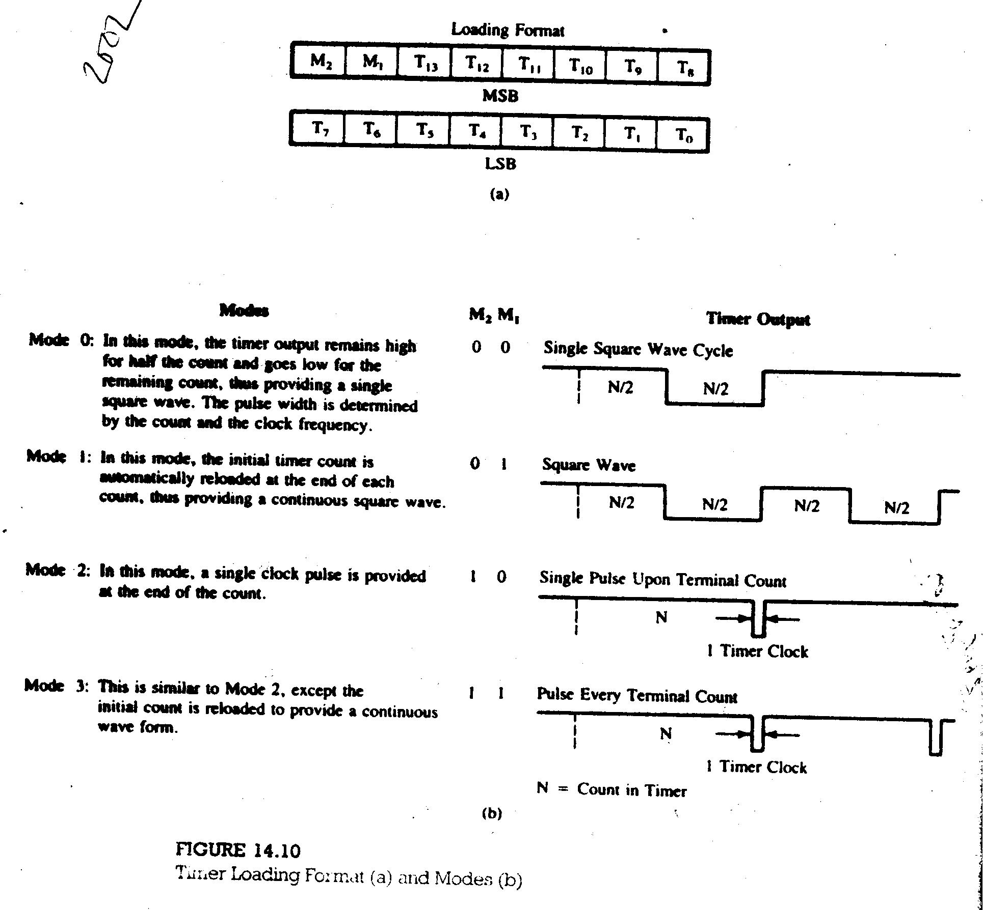

Slide 20
Clock Period = 1/f = 1/3 x 10⁶ = 330 ns
Timer Count = Pulse Period / Clock Period = 200 x 10⁻⁶ / 330 x 10⁻⁹ = 606
Count = 025EH
The port addresses for the timer registers are
Timer LSB = 24H
Timer MSB = 25H
The least significant byte, 5EH (of the count 025EH), should be loaded in the timer register with address 24H. The most significant byte is determined as follows:
M₂ M₁ T₁₃ T₁₂ T₁₁ T₁₀ T₉ T₈
0 1 0 0 0 0 1 0 = 42H
Therefore, 42H should be loaded in the timer register with the address 25H.

Slide 21
CONTROL WORD
Ports A and B are used as output port; therefore, the control word is:
D₇ D₆ D₅ D₄ D₃ D₂ D₁ D₀
1 1 0 0 0 0 1 1 = C3H
Initialization Instructions
        MVI A, 5EH
        OUT 24H
        MVI A,42H
        OUT 25H
        MVI A, C3H
        OUT 20H
        HLT

Slide 22
14.2.5 The 8155 I/O Ports in Handshake Mode
In the handshake mode, data transfer occurs between the MPU and peripherals using control signals called handshake signals. Two I/O ports of the 8155, A and B, can be configured in the handshake mode; each uses three signals from port C as control signals (Figure 14.11). Another alternative (ALT3 in the table in Figure 14.8) available in the 8155 is to configure port A in the handshake mode with three control signals from port C, configure port B as simple I/O, and configure the remaining three bits from port C as outputs.
CONTROL SIGNALS IN HANDSHAKE MODE
When both ports A and B are configured in the handshake mode, port A uses the lower three signals of port C (PC₀, PC₁, and PC₂), and port B uses the upper three signals (PC₃, PC₄, and PC₅), as shown in Figure 14.11. The function of these signals are:
STB (Strobe Input): The low signal on this pin informs the 8155 that data
are strobed into the input port.
BF (Buffer Full): The high signal on this pin indicates the presence of a
data byte in the port.

Slide 23
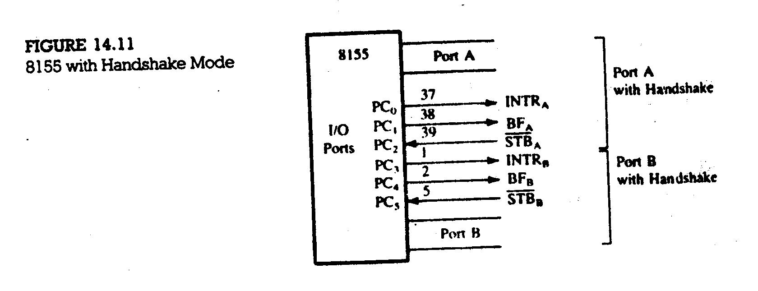

Slide 24
INTR (Interrupt Request): This signal interrupts the processor to read an
existing data from its (8155) input port or write a new data to its output port.
INTE (Interrupt Enable) : This is an internal flip-flop used to enable or disable the interrupt capability of the 8155. The interrupts for port A and B are controlled by bits D₄ and D₅ respectively, in the control register.
These control signals can be used to implement either interrupt I/O or status check I/O.
INPUT
Figure 14.12 (a) shows the sequence of events and timing in data input to the 8155.
1.
2.
3.
4.

Slide 25
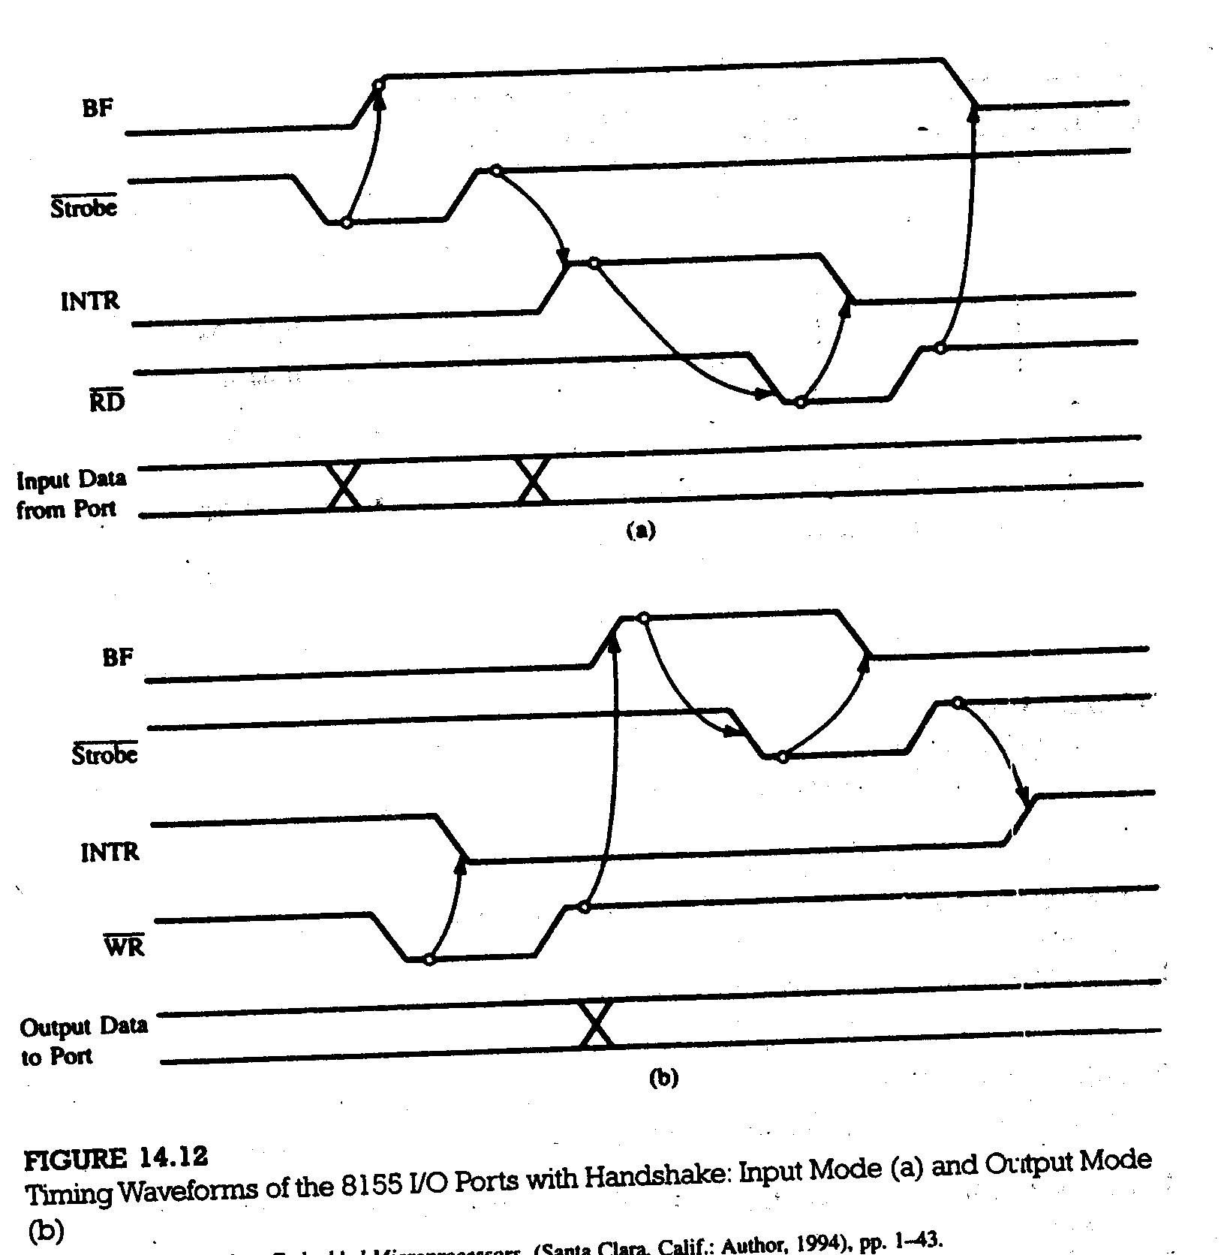

Slide 26
OUTPUT
Figure 14.12 (b) shows the sequence of events and timing in data output to the 8155.
1.
2.
3.
4.
STATUS WORD
The MPU can read the status register to check of the timer. The control register and the status register have the same port address; they are differentiated only by RD and WR signals. The status register bits are defined in Figure 14.13.

Slide 27
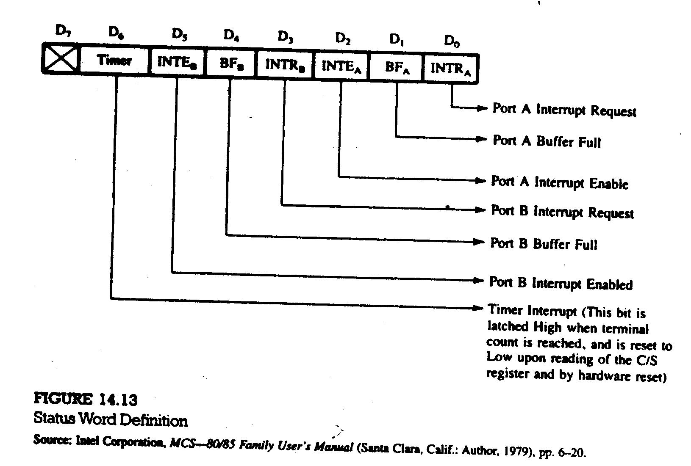

Slide 28
14.2.6 Illustration: Interfacing I/O Ports in Handshake Mode using the 8155
PROBLEM STATEMENT
Design an interfacing circuit using the 8155 read and display form an A/D converter to meet the following requirements:
1. Set up port A in the handshake mode to read data from A/D converter.
2. Set up port B as an output port to display data at seven-segment LEDs.
3. Use line PC₃ from port C to initiate a conversion.

Slide 29
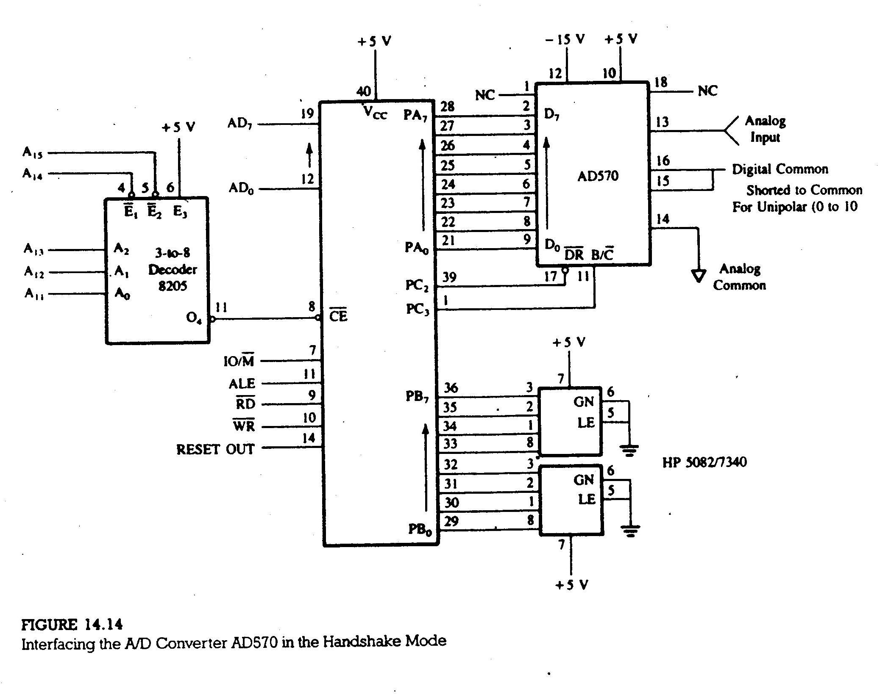

Slide 30
PROBLEM ANALYSIS
The circuit shows that the INTR signal (bit PC_{o}) is not being used. This suggests that port A is configured for status check and not for interrupt I/O. Therefore, the control word:
D₇ D₆ D₅ D₄ D₃ D₂ D₁ D₀
0 0 0 0 0 1 1 0 = 06H
8155 Timer
To start the timer, the control word:
D₇ D₆ D₅ D₄ D₃ D₂ D₁ D₀
1 1 0 0 0 1 1 0 = C6H
To stop the timer, the control word:
D₇ D₆ D₅ D₄ D₃ D₂ D₁ D₀
0 1 0 0 0 1 1 0 = 46H

